Slide 1
INTERNSHIP STUDIO
ETHICAL HACKING INTERNSHIP
TASK 3
AISWARYA UNNIKRISHNAN
uaiswarya769@gmail.com

Slide 2
REPORT
Domain>> http://testasp.vulnweb.com/
Subdomain>> http://testasp.vulnweb.com/Search.asp/
TESTING ENVIRONMENT>> Kali Linux, Burpsuit 2020.12.1
DISCRIPTION>>CROSS SITE SCRIPTING FOUND
STEPS TO REPRODUCE>>
Step 1: First visited the site http://testasp.vulnweb.com/
Step 2: Click on the search button and a search box appears
Step 3: Opened Burp Suit and intercept the request with it.
Step 4: redirectrd the request to intruder.
Step 5:Found different payloads for XSS using google
Step 6: pasted all the payloads and start scanning

Slide 3
Step 7: successful payload was found and was sented it to interpreter and forward it.
VULNERABILITY IN DETAIL>>
<body oninput=javascript:alert(1)><input autofocus>
The respective pay load was executed. As a result a input bar appeared in below the search bar and when we input something on it a alert box appear with 1 written in it. So to conclude that the site is vulnerable to cross site scripting.
IMPACT
A black hat hacker can easly stole sensitive informations like users id, password and much more.

Slide 4
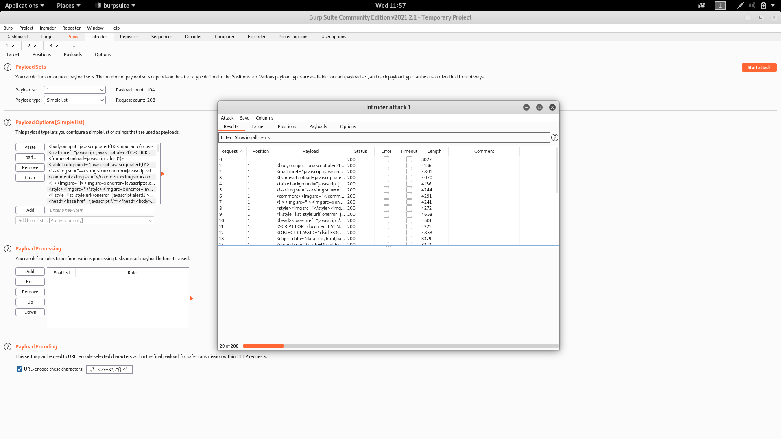

Slide 5
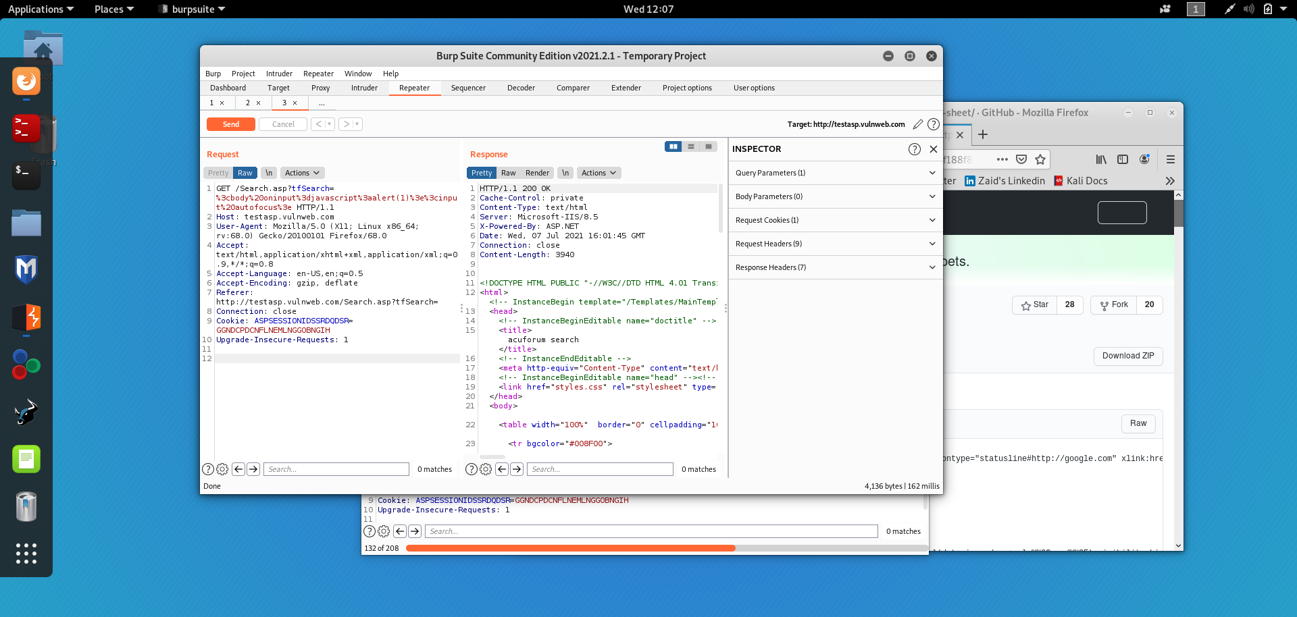

Slide 6
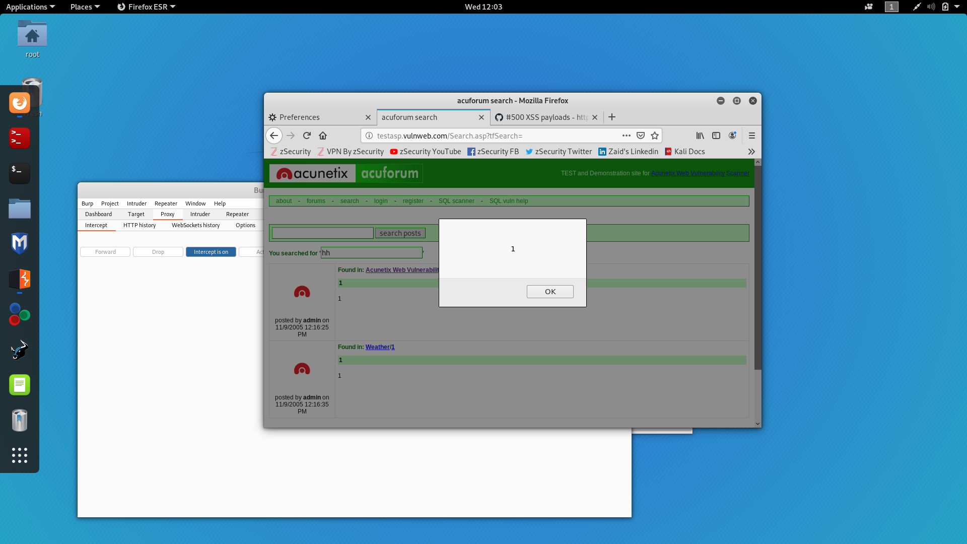

Slide 7
